Slide 1

Artificial Intelligence Ethics
Wanyue Xiao
Course: IST707
Notes:
更多模板请访问PPT超市网站：www.pptchaoshi.com

Slide 2
TABLE OF CONTENTS
01
02
03
Major Ethical Issues
Ethical Issues in Data
Difficulty of De-biasing
04
05
06
Solutions for De-biasing
References
CONCLUSIONS
Nine ethical issues in AI
Three Types of Data Bias
Four reasons why it is hard to fix biases
Briefly introduce potential solutions for solving bias
References List of researches
The end of the presentation

Slide 3
01 Major Ethical Issues
From sociological perspective, there are major 9 ethical issues.

Slide 4









Ethical Issues caused by AI
Unemployment
Security
Inequality
Robots Rights
Humanity
Artificial Stupidity
Singularity
How to handle unemployment caused by AI
How to prevent AI from being used maliciously
Evil Genies
What should we do when singularity achieve
How to distribute the wealth
How do we protect against unintended consequences
Racist Robots
What rights should be given to robots
How do we eliminate AI bias
How do machines affect our behavior and interaction
How to make sure AI won’t make mistakes

Slide 5
02 Data Bias Issues
From algorithmic perspective, there are 3 types of biases
Notes:
更多模板请访问PPT超市网站：www.pptchaoshi.com

Slide 6
Algorithmic Perspectives
Data Biases
Constrains around Data
Algorithmic Principles
Framing the Problem
Collecting the Data
e.g. Amazon recruiting system
Preparing the Data
e.g. selection of attributes
Irrelevant information might influence the prediction result
e.g. Detect fish and apple hold by hand
The most nebulous of bias challenges
e.g. Amazon resume selection system
Notes:
更多模板请访问PPT超市网站：www.pptchaoshi.com

Slide 7
03 Difficulty in solving bias

Slide 8



Why it is hard to fix those biases
Hard to identify where the bias came from and find solution to get rid of it
Fail to flag skewed or prejudiced results due to lack of bias detection process
Every case has different versions of fairness
Sometimes fairness could be exclusive to each other
Unknown Unknowns
Imperfect Processes
Lack of Social Context
Definition of Fairness

Slide 9
04 Potential Solutions
Fixing discrimination in data and algorithmic systems could be difficult, but we have to do it

Slide 10
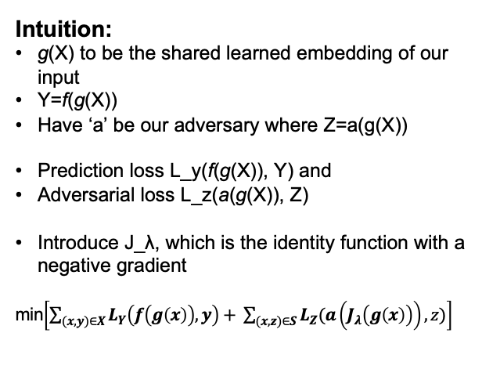
Adversarial De-biasing Method
Dataset
Intuition:
g(X) to be the shared learned embedding of our input
Y=f(g(X))
Have ‘a’ be our adversary where Z=a(g(X))
Prediction loss L_y(f(g(X)), Y) and
Adversarial loss L_z(a(g(X)), Z)
Introduce J_λ, which is the identity function with a negative gradient
min$\left[\sum_{(x,y)∈X}{L_{Y}\left(f\left(g\left(x\right)\right),y\right)+ \sum_{(x,z)∈S}{L_{Z}(a\left(J_{λ}\left(g\left(x\right)\right)\right),z)}}\right]$
Y -> predicted label -> ‘Credit’
X -> attributes inside the dataset -> ’Income’
Z -> sensitive attributes -> ‘Race’
Goal: train the model to
simultaneously predict the label Y
prevent a jointly-trained adversary from predicting Z
Age
Gender
Education Level
Race
Disability

Slide 11
Other Solutions
B
C
Dynamic up-sampling of training data to tackle biases in training data
Distributional robust optimization directly modifies the optimization objective

Slide 12
REFERENCES
Baxter, M 2019, AI ethics and how adversarial algorithms might be the answer, Information Age, Viewed at April 8, 2020.
Bardley, AJ 2020, 4 stages of Ethical AI: Algorithmic Bias is not the Problem but Part of the Solution, Gartner, Viewed at April 8, 2020.
Insight Team 2019, Managing The Ethics of Algorithms, Forbes, Viewed at April 8, 2020.
Silberg, J & Manyika, J 2019, Tackling bias in artificial intelligence (and in humans), McKinsey&Company, Viewed at April 8, 2020.
Xu, J 2019, Algorithmic Solutions to Algorithmic Bias: A Technical Guide, Media, Viewed at April 8, 2020.

Slide 13
THANKS!
Does anyone have any questions?
Please contact me through xwanyue@syr.edu
Notes:
更多模板请访问PPT超市网站：www.pptchaoshi.com

